Slide 1
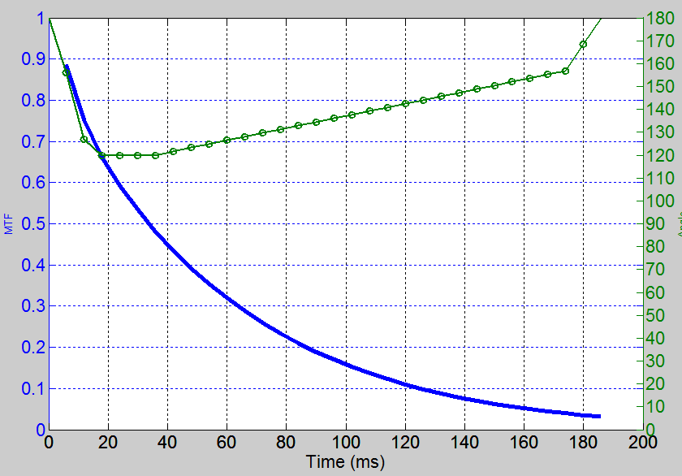
T1 1000ms
T2 50ms
Low-High Readout
Turbo: Y-Z
TSE factor: 31
Startup echoes: 0
Plateau(ms): 1*TE
Refocusing Control: Tissue Specific
TEes 6ms

Slide 2
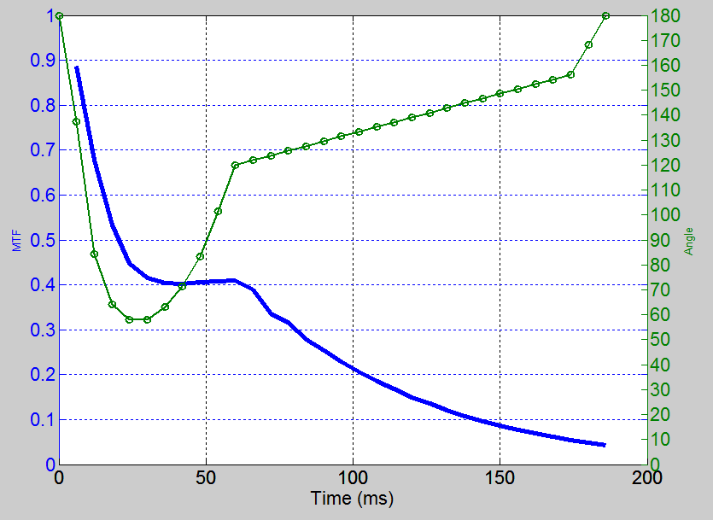
T1 1000ms
T2 50ms
Linear Readout
Turbo: Y-Z
TSE factor: 31
Startup echoes: 0
Plateau(ms): 1TE
Refocusing Control: Tissue Specific
TEes 6ms

Slide 3
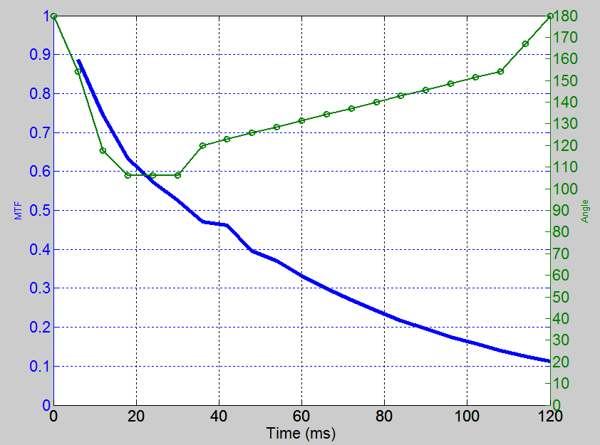
T1 1000ms
T2 50ms
Linear Readout
Turbo: Y-Z
TSE factor: 20
Startup echoes: 0
Plateau(ms): 1TE
Refocusing Control: Tissue Specific
TEes 6ms

